Slide 1

So, you are a Lutheran…
What does that mean?

Slide 2
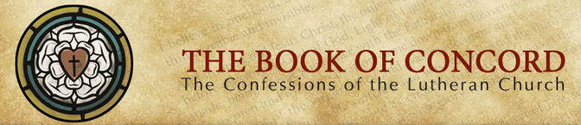
Lutherans have always been defined by their beliefs, what we understand the Scriptures to teach. These beliefs are written in documents called our Confessions:
The Three Creeds (Apostles, Nicene, Athanasian)
The Augsburg Confession
The Apology to the Augsburg Confession
The Smalcald Articles
Treatise on the Power and Primacy of the Pope
The Small Catechism
The Large Catechism
Formula of Concord

Slide 3
At the center of all of these confessions stands
The Augsburg Confession
The Lutheran Church sets aside June 25 each year to remember the presentation of this important confession.
Short history: The Holy Roman Emperor Charles V had called on the Princes and Free Territories in Germany to explain their religious convictions in an attempt to restore religious and political unity in the Holy Roman Empire, and rally support against the Turkish invasion. The Augsburg confession was the Reformers formal answer to this request, and was presented in Latin and German at the Diet of Augsburg in 1530.

Slide 4
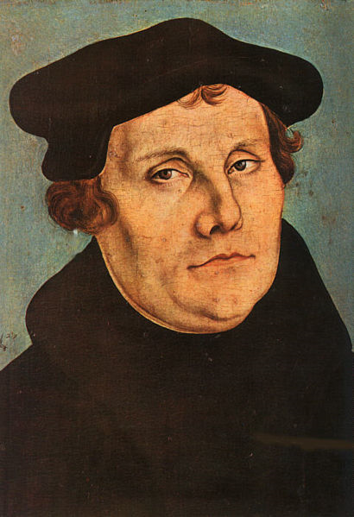
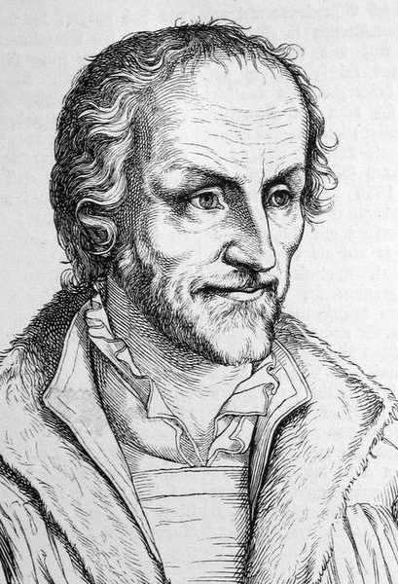
The Augsburg Confession
Phillip Melanchthon took the lead in editing the confession, using previously drafted articles of faith along with other writings from Luther. He also send drafts to Luther for comments or corrections.
Luther was not allowed to move freely since Charles had deemed him an outlaw at a previous Diet.

Slide 5
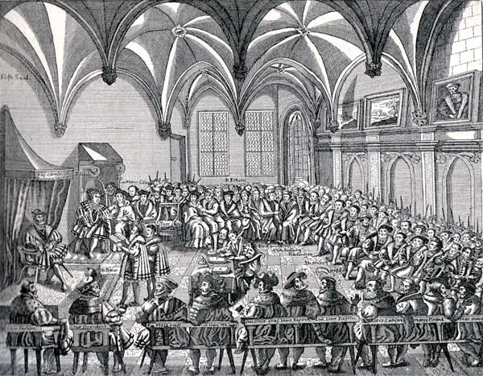
The Presentation of The Augsburg Confession
The German version of the confession was read aloud on June 25, 1530 in Augsburg . It took over two hours and was read loud enough so those outside could hear it.

Slide 6
The Augsburg Confession: What is in it?
Article Title | What is in it?
I. God | Confesses God as Triune: Three Persons, One Essence
II. Original Sin | All are born sinful and cannot save themselves. Original sin is true damnable sin.
III. Son of God | Jesus is 100% Man / 100% God. Repeats Apostles Creed’s statements about all that Jesus did on our behalf.
IV. Justification | Man is saved only by grace through faith. Works play no role in one’s salvation.
V. Preaching | In order that all might be saved, God gave the Church the Office of the Ministry, empowered with the Word and Sacraments.
VI. New Obedience | Faith produces good works naturally.
VII. The Church | The Church is where the gospel is purely preached and the sacraments are rightly administered. Unity the church is formed around agreement on these matters.

Slide 7
The Augsburg Confession: What is in it?
Article Title | What is in it?
VIII. What is the Church | The true church is comprised of all genuine believers.
IX. Baptism | Baptism is a necessary mean of grace. Infants and children are to be baptized.
X . The Lord’s Supper | The true body and blood of Christ are present in this meal under the bread and wine.
XI. Confession | Private absolution should be retained. One does not have to confess every sin before a pastor for it to be forgiven.
Repentance | Repentance is contrition, which recognizes sin, and faith, which trusts Jesus to forgive it. It is a practice meant for the entire Christian life.
XIII. Use of Sacraments | The Sacraments are God’s means of grace and must be received in faith and for the strengthening of faith.
XIV. Church Government | No one should publically teach, preach, or administer the Sacraments with a proper call from the Church.

Slide 8
The Augsburg Confession: What is in it?
Article Title | What is in it?
XV. Church Regulations | Church traditions made by man should be kept when they help with good order and do not cause sin. No human tradition is meritorious unto salvation.
XVI. Secular Government | Government is created by God to execute justice and Christians may participate freely in secular government in any capacity.
XVII. Return of Christ to Judgment | Jesus will return. Eternal life will be received by all who believe . Eternal punishment will be given to all who do not believe.
XVIII. Free Will | In regards to daily choices, man has some free will. However he has no free will to choose God or become righteous.
XIX. Cause of Sin | The cause of all sin is man’s perverted will and the activity of the devil.
XX Faith and Good Works | Christians are to be exhorted to the good work revealed in the Word, but not to supposed good works created by men. No work earns salvation.
XXI. Cult of the Saints | Former saints are to be remembered and used as examples. However, our prayers are not to be directed to them.

Slide 9
The Augsburg Confession: What is in it?
Article Title | What is in it?
XXII. Both Kinds in the Sacrament | Both the bread and the wine should be given to the laity.
XXIII. Marriage of Priests | Priests are free to marry.
XXIV. The Mass | The Mass (the Lord’s Supper) is celebrated with joy and regularity not as a sacrifice we offer to God, but a sacrament God offers to us.
XXV. Confession | Confession is practiced. Absolution is stressed. Enumeration of every sin is not necessary.
XXVI. Distinction among Foods | Fasts and distinctions concerning which foods to eat are good discipline, but are not to be talked about as earning salvation.
XXVII. Monastic Vows | Monastic life cannot earn salvation. Those who took vows with misunderstanding are free. “Normal” life is God pleasing.
XXVIII. Power of Bishops | Bishops do not have secular power. Their power is the Gospel and the Sacraments and only with this power do they rule in the church of Christ.

Slide 10
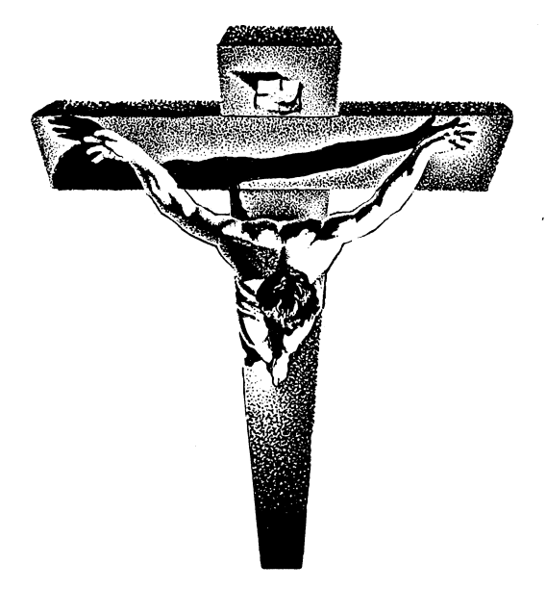
The center of all of these articles is this from the fourth article of the Augsburg Confession.
        “Men cannot be justified before God by their own strength, merits, or works, but are freely justified for Christ's sake, through faith, when they believe that they are received into favor, and that their sins are forgiven for Christ's sake, who, by His death, has made satisfaction for our sins. This faith God imputes for righteousness in His sight.”
This “center” is what drives all churches who hold to the Augsburg Confession this day. It is what should drive each of us who call ourselves Lutherans as well.
Read more about the Augsburg confession at http://www.bookofconcord.org

